Slide 1
Autonomous Mobile Robot Final Project Presentation
Anurag Roy
Bowen Hu
Chun Pok Lam
Krishnapur Praveen Kumar
Jinhan Xue
Yurong Liu
Group 4

Slide 2
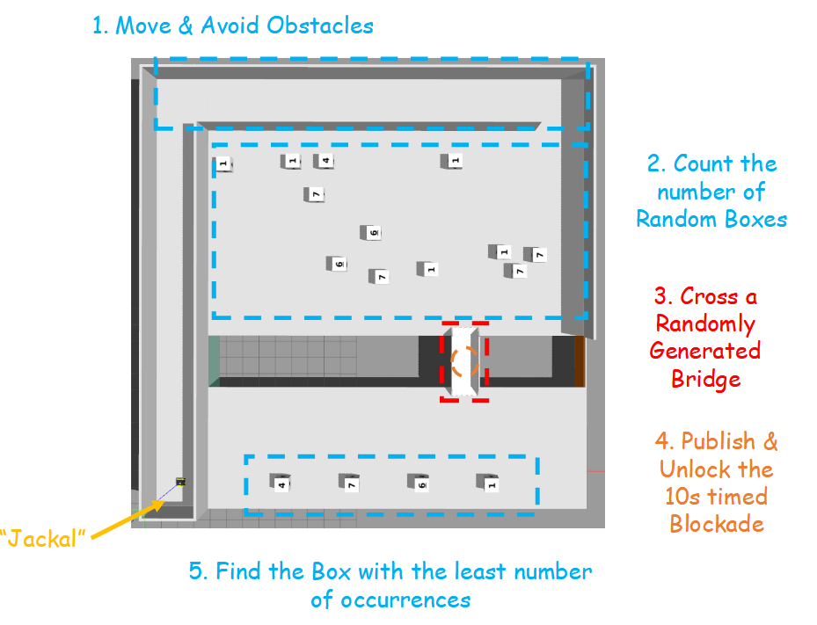
Introduction
Task 1: Mapping
SLAM Methods
Localization
Task 2: Navigation
Global Planning
Local Planning
Exploration Policy
Perception
Fig. 1 Simulation Environment

Slide 3
Task 1: Mapping

Slide 4
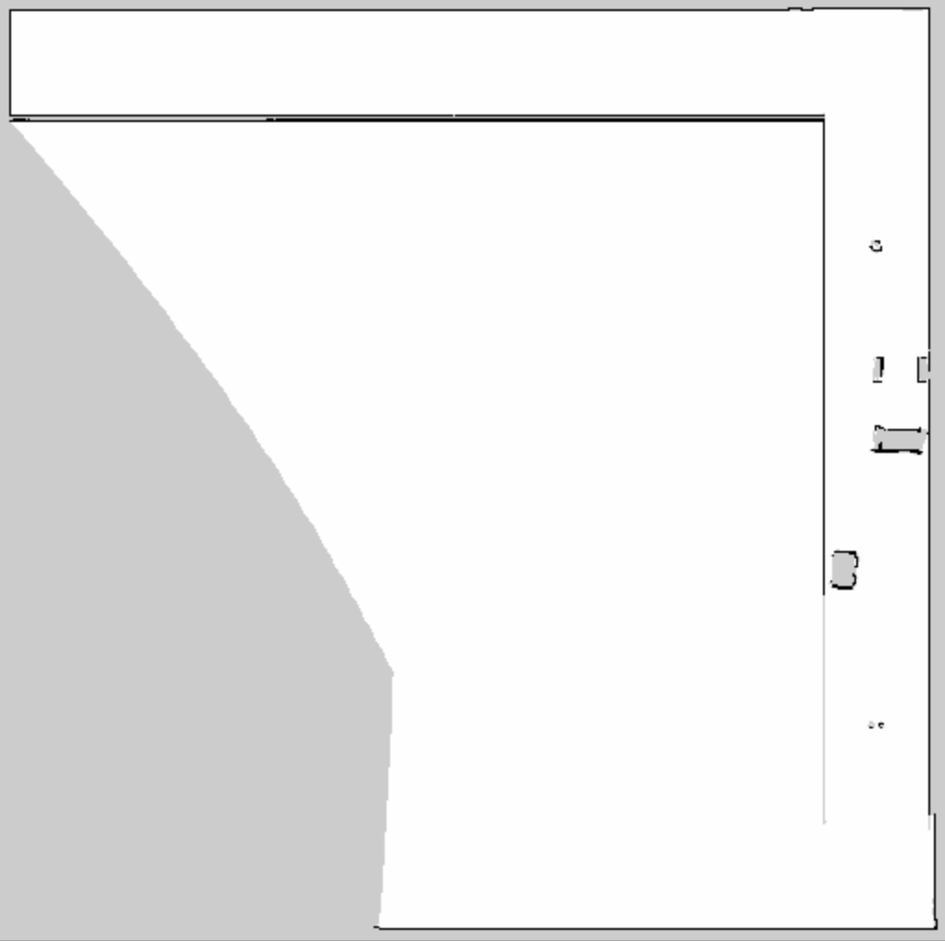
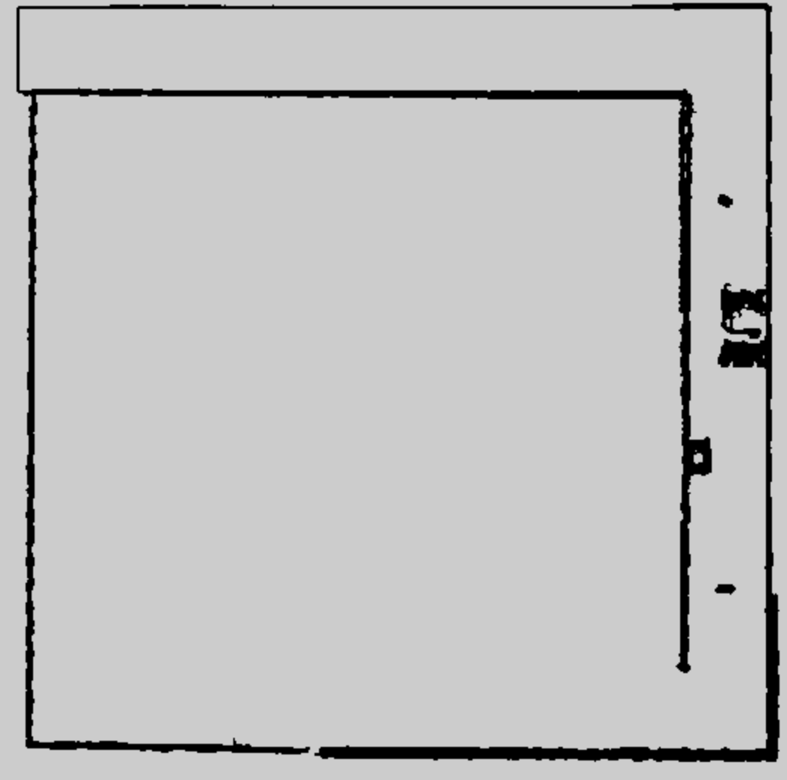
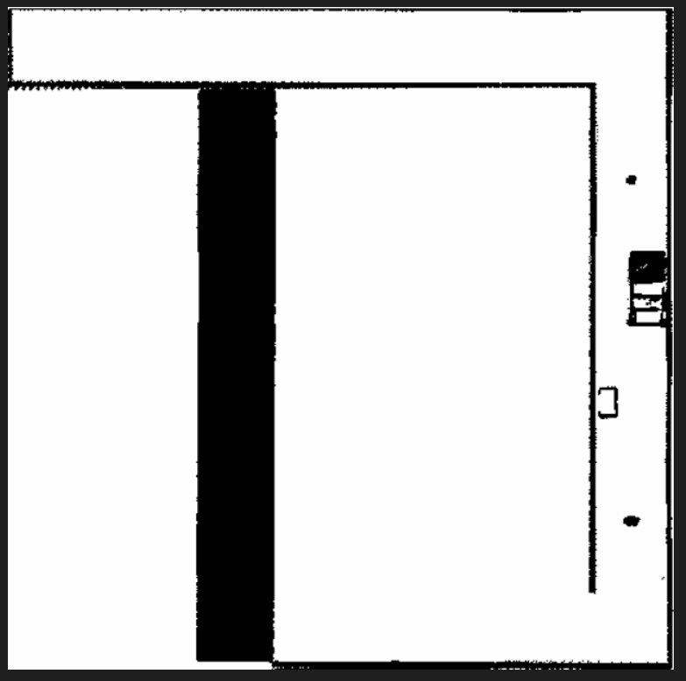
SLAM Methods and Mapping Results
Cartographer 2D
Cartographer 3D
Fast-LIO2
Fig. 2 Mapping Built by Different SLAM Algorithms
2D LiDAR + IMU + odometry
Efficient for structured indoor scenes but fails to capture distant features in open areas
VLP-16 3D LiDAR + IMU + odometry
Captures complete 3D structures with improved spatial coverage
VLP-16 3D LiDAR+IMU
Provides high accuracy and low drift in sparse-feature environments

Slide 5
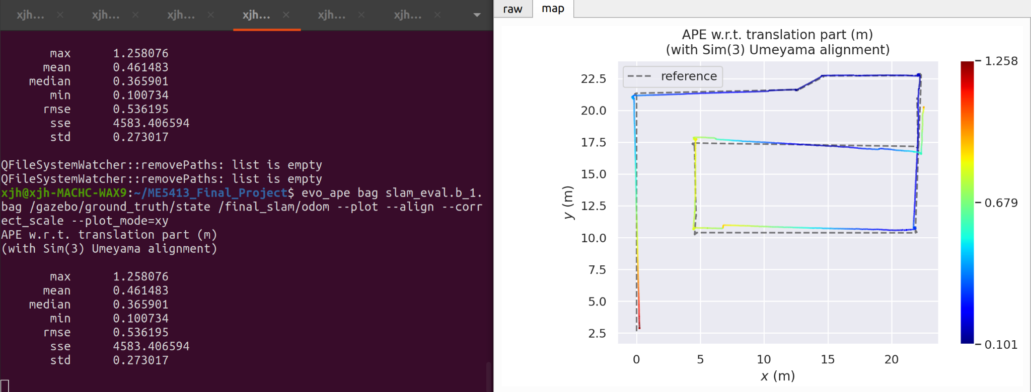
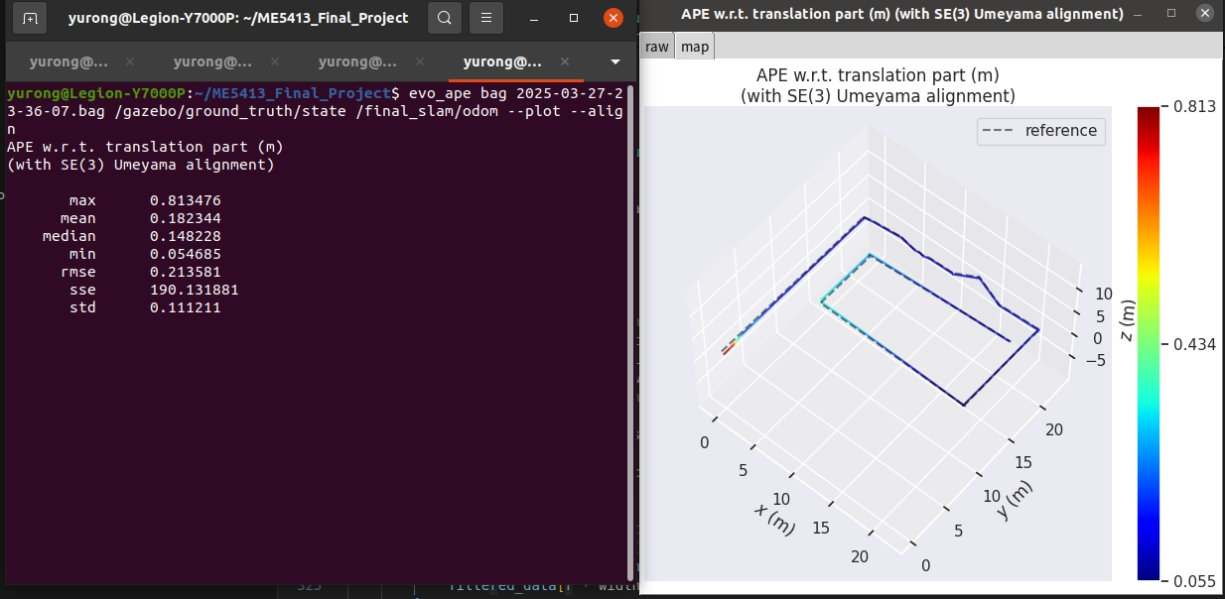
Evaluation
APE of Cartographer 3D
APE of Fast-LIO2
Fig. 3 EVO of Cartographer 3D and Fast-LIO2

Slide 6
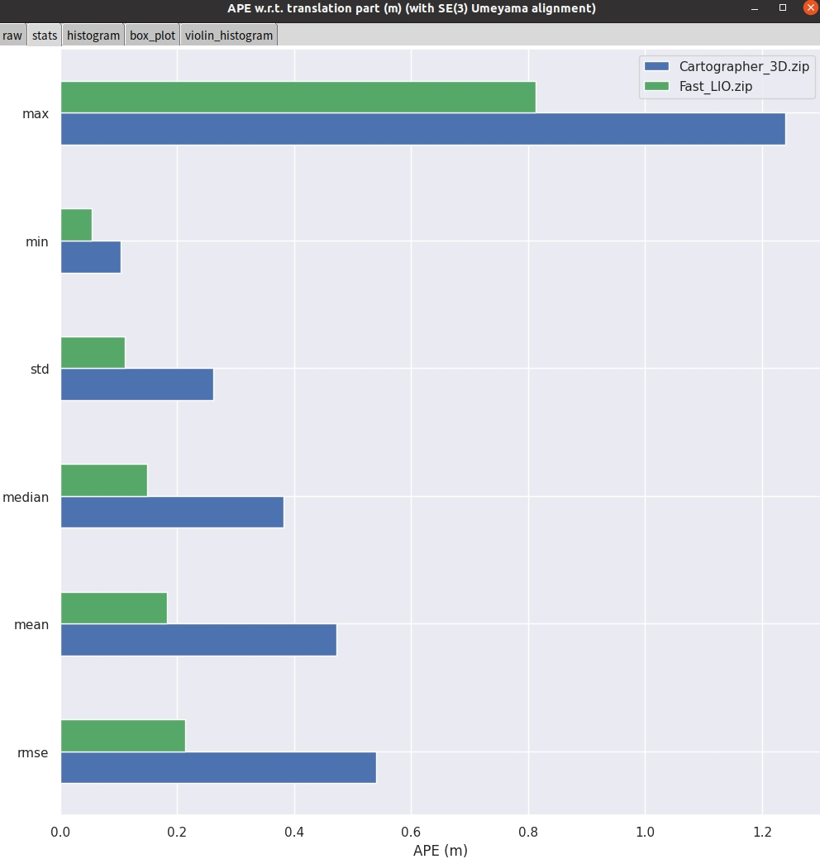
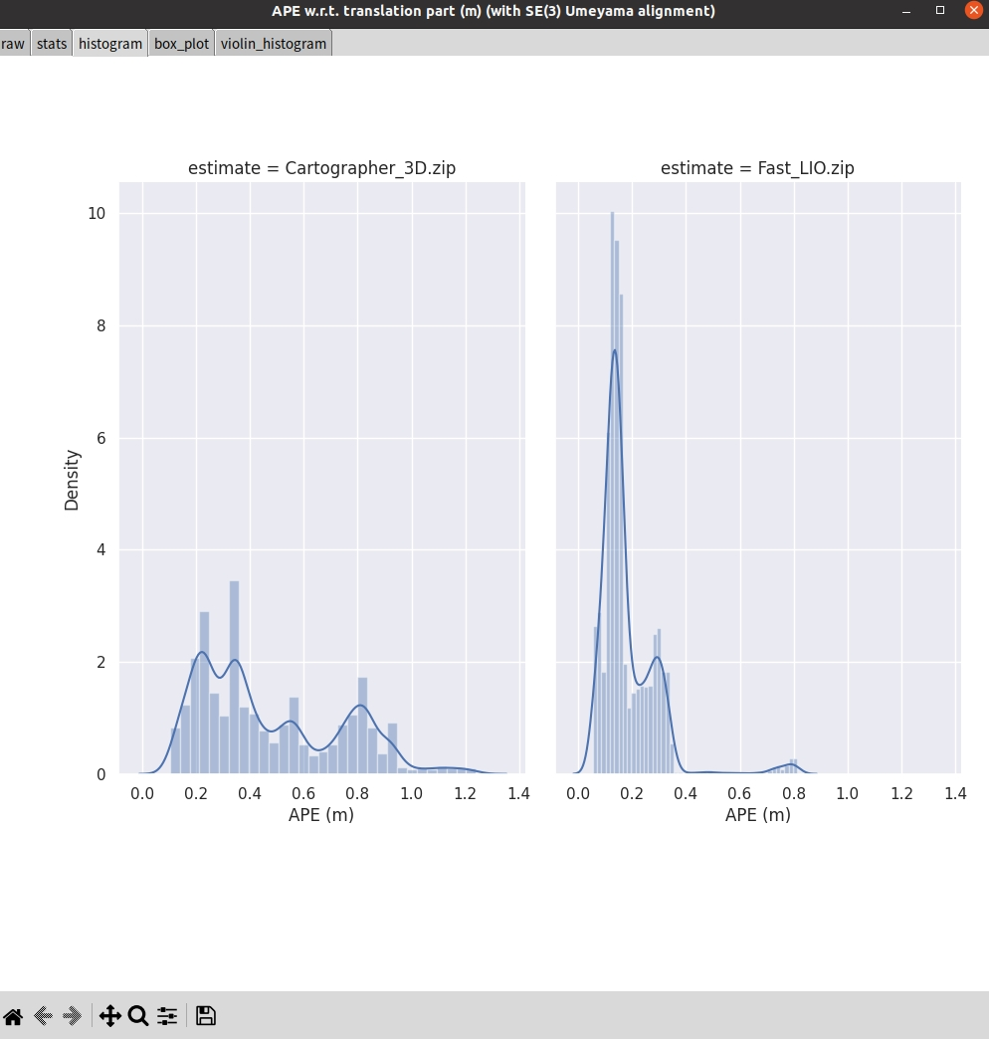
Evaluation
Fig. 7 APE Analysis of Cartographer and Fast-LIO

Slide 7
Evaluation
Tab. 1 EVO Evaluations
Evaluation Metric (m) | Cartographer 3D | Fast-LIO2
Max APE | 1.258 | 0.813
Mean APE | 0.461 | 0.182
Median APE | 0.366 | 0.148
Min APE | 0.101 | 0.057
RMSE | 0.536 | 0.214
Better

Slide 8
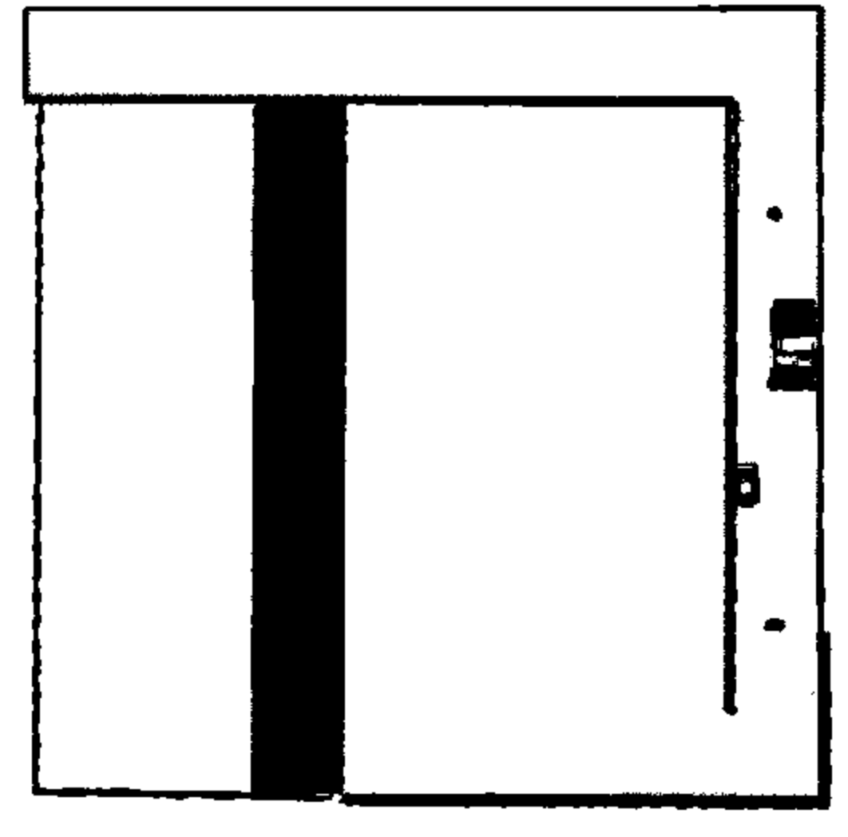
Map Fusion
Cartographer 2D Map
Cartographer 3D Map
Fast-LIO Map
Fused Map
Fig. 4 Map Fusion from Multiple SLAM Algorithms"

Slide 9
Task 2: Navigation

Slide 10
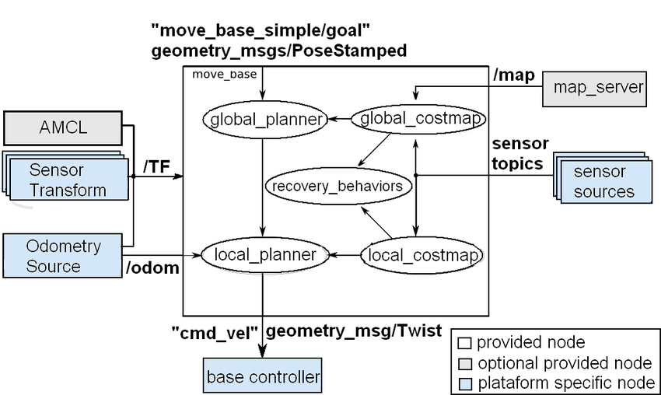
Navigation-Workflow

Slide 11
Navigation
Global Planners
Optimal guarantee
Complete but slow
With heuristics guidance
Efficient
Fast in complex environment
Suitable for non-holonomic planning
No optimal guarantee
Dijkstra
A*
RRT

Slide 12
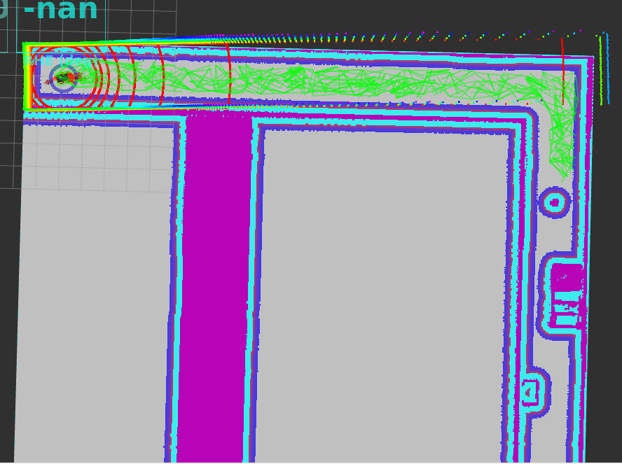
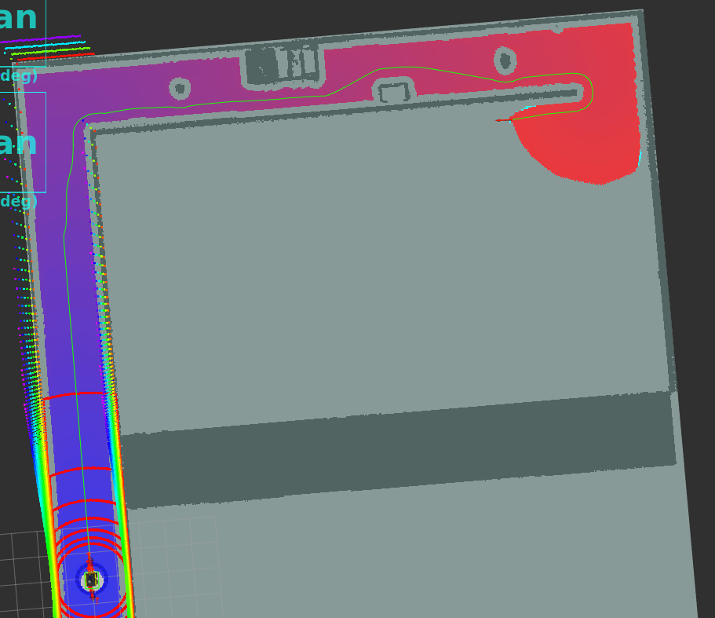
Navigation
Global Planners
RRT
A*

Slide 13
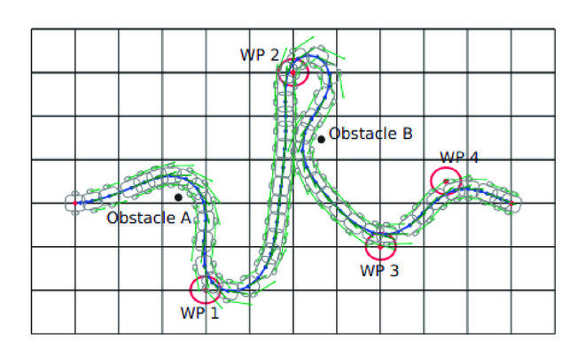
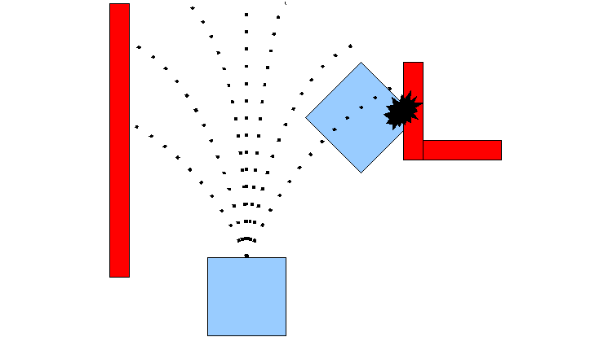
Navigation
Local Planners
DWA
TEB
Sample actions
Simulate short-term trajectories
Select optimal action based on object function
Fast & Simple
less efficient in narrow spaces
Optimize full trajectory over time
Considers timing
Adapts well to narrow spaces
Smoother & feasible paths

Slide 14
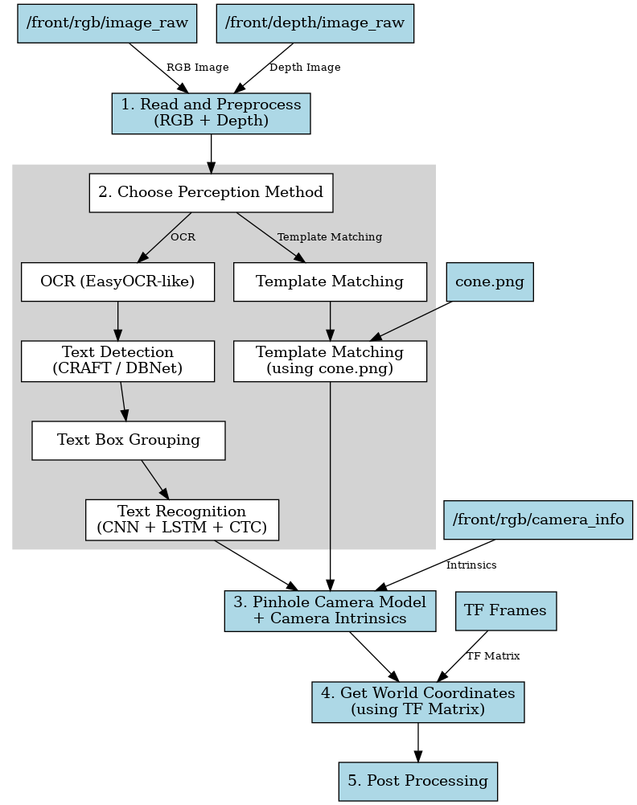
Perception
Number Tracking
Bridge Detection
Cube Localisation

Slide 15
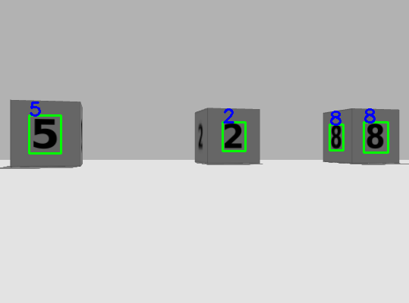
Perception - Number Detection
Detects digits on cube surfaces using EasyOCR
Tracks frequency of each number across frames
Avoids repeated counting of the same number
Associates each detected number with its corresponding cube

Slide 16

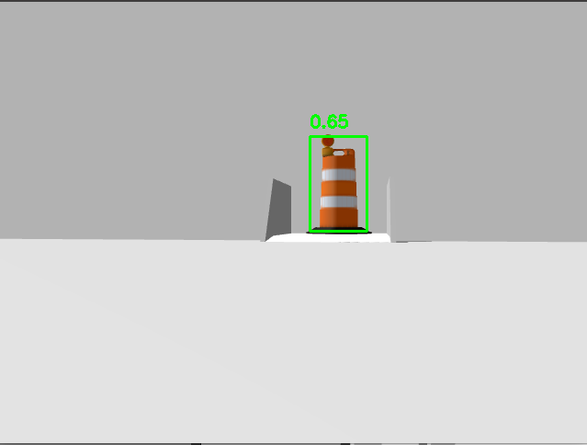
Perception - Cone Detection
Detects cones using a reference template in HSV color space
Uses HSV for better color matching under varying lighting
Helps identify bridge entrances based on cone position

Slide 17
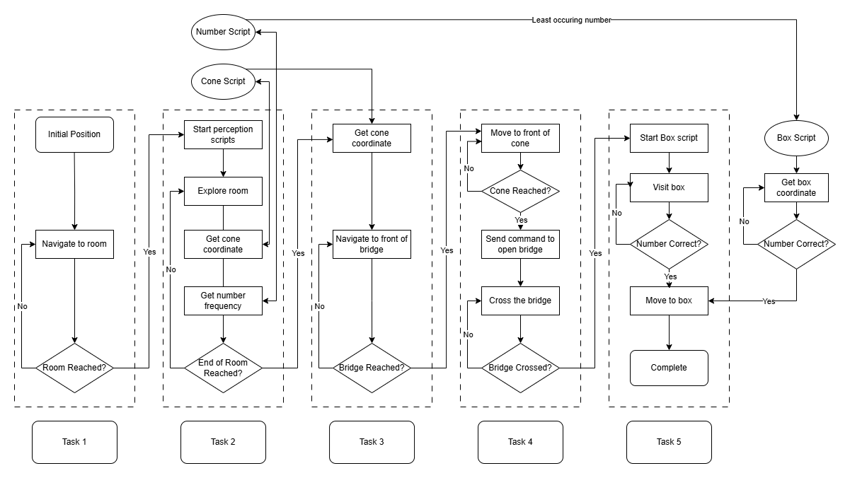
Finite State Machine

Slide 18
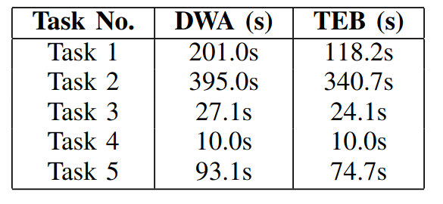
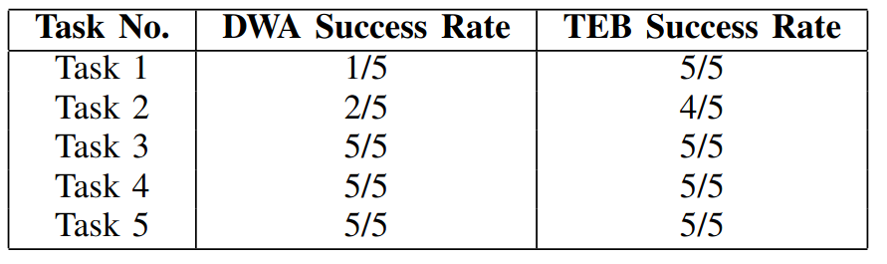
Final
Evaluation
Table 2: Path Completion Time at v=1.0
Table 3: Navigation Success Rate for 5 attempts

Slide 19
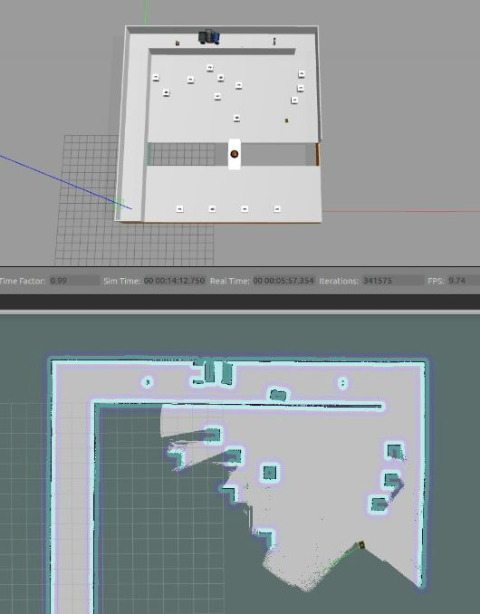
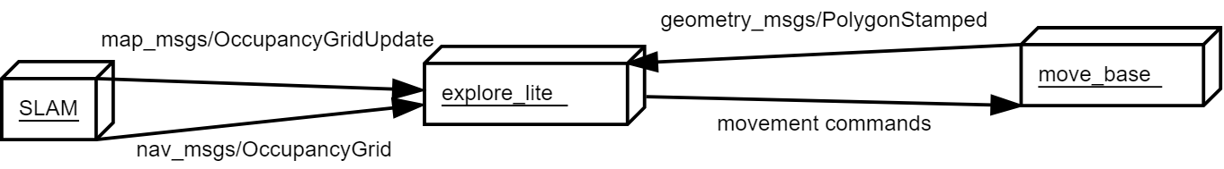
Future Work
Autonomous mapping & exploration with ROS package explore_lite

Slide 20
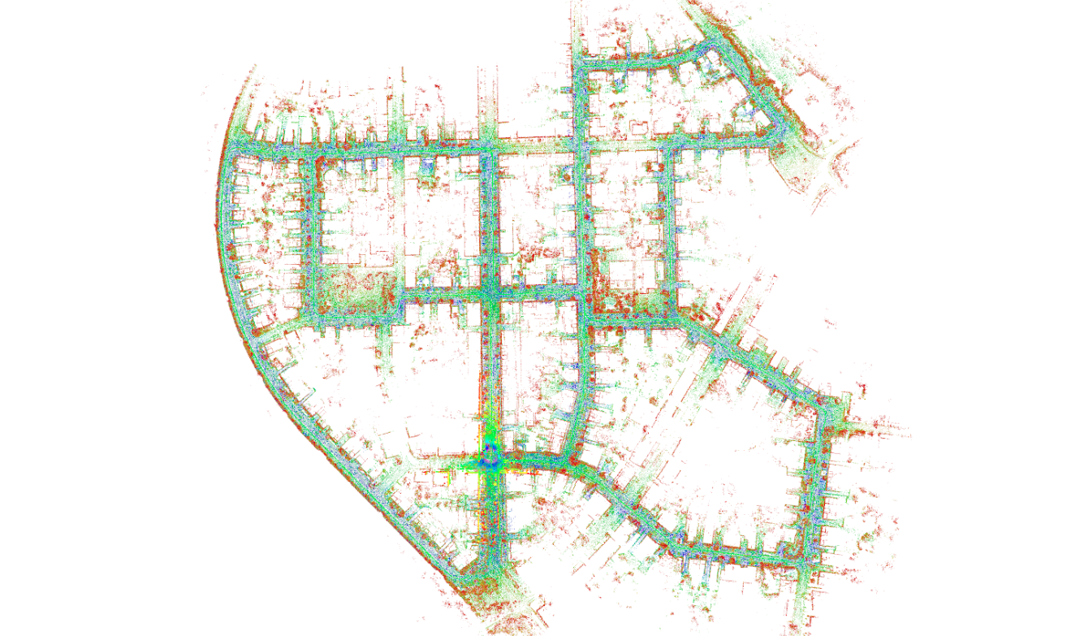
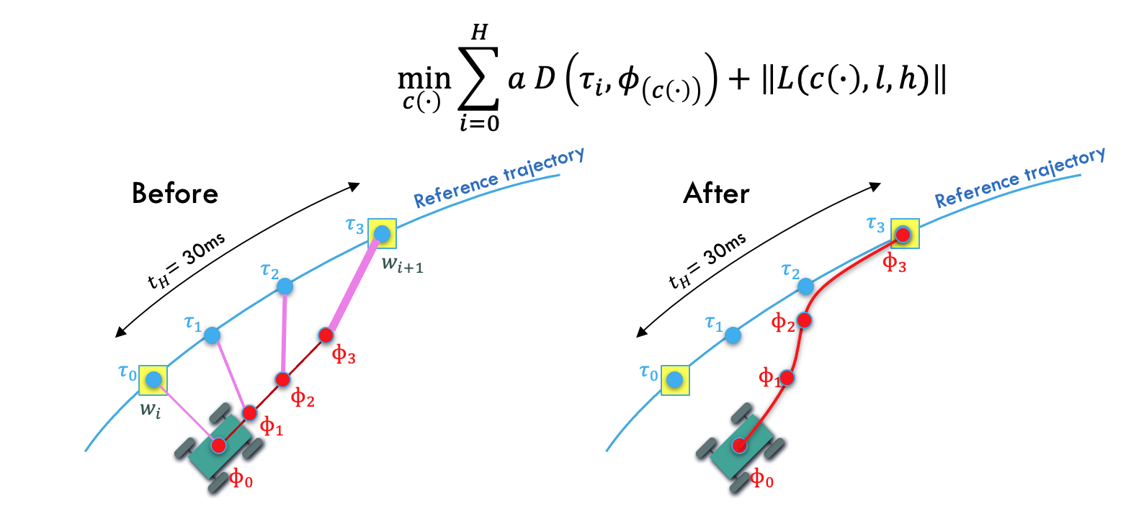
Future Work
A-LOAM
MPC Local Planner

